Slide 1




Carl’s Ultra-Basic Guide to the Command Line and Git
Carl G. Stahmer
Director of Data and Digital Scholarship
Associate Director for Humanities
UC Davis Data Science Initiative
www.carlstahmer.com
www.digitalscholarslab.org
@cstahmer
Rare Book School
Digital Approaches to Bibliography and Book History
July 2017

Slide 2


HD | C://
Folders You Know and Love
Folder 1
Folder A
Folder 2
Folder B
Folder 3
Folder 4
Folder C
@cstahmer

Slide 3

HD | C://
C://Folder 1/Folder A
Folders You Know and Love
Folder 1
Folder A
Folder 2
Folder B
Folder 3
Folder 4
Folder C
@cstahmer

Slide 4
HD | C://
C://Folder 4/Folder C
Folders You Know and Love
Folder 1
Folder A
Folder 2
Folder B
Folder 3
Folder 4
Folder C
@cstahmer

Slide 5
/ (Root Directory)
Unix Directory Structure
Directory_1
Directory_A
Directory_2
Directory_B
Directory_3
Directory_4
Directory_C
@cstahmer

Slide 6
/ (Root Directory)
/Directory_1/Directory_A
Unix Directory Structure
Directory_1
Directory_A
Directory_2
Directory_B
Directory_3
Directory_4
Directory_C
@cstahmer

Slide 7
/ (Root Directory)
/Directory_1/Directory_A
Unix Directory Structure
Directory_1
Directory_A
Directory_2
Directory_B
Directory_3
Directory_4
Directory_C
@cstahmer

Slide 8
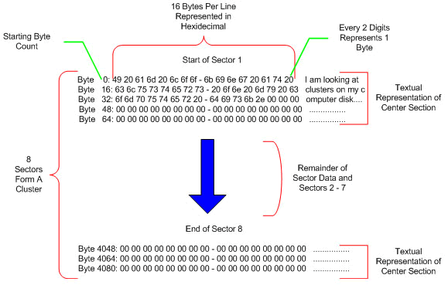
Why Directory?

Slide 9
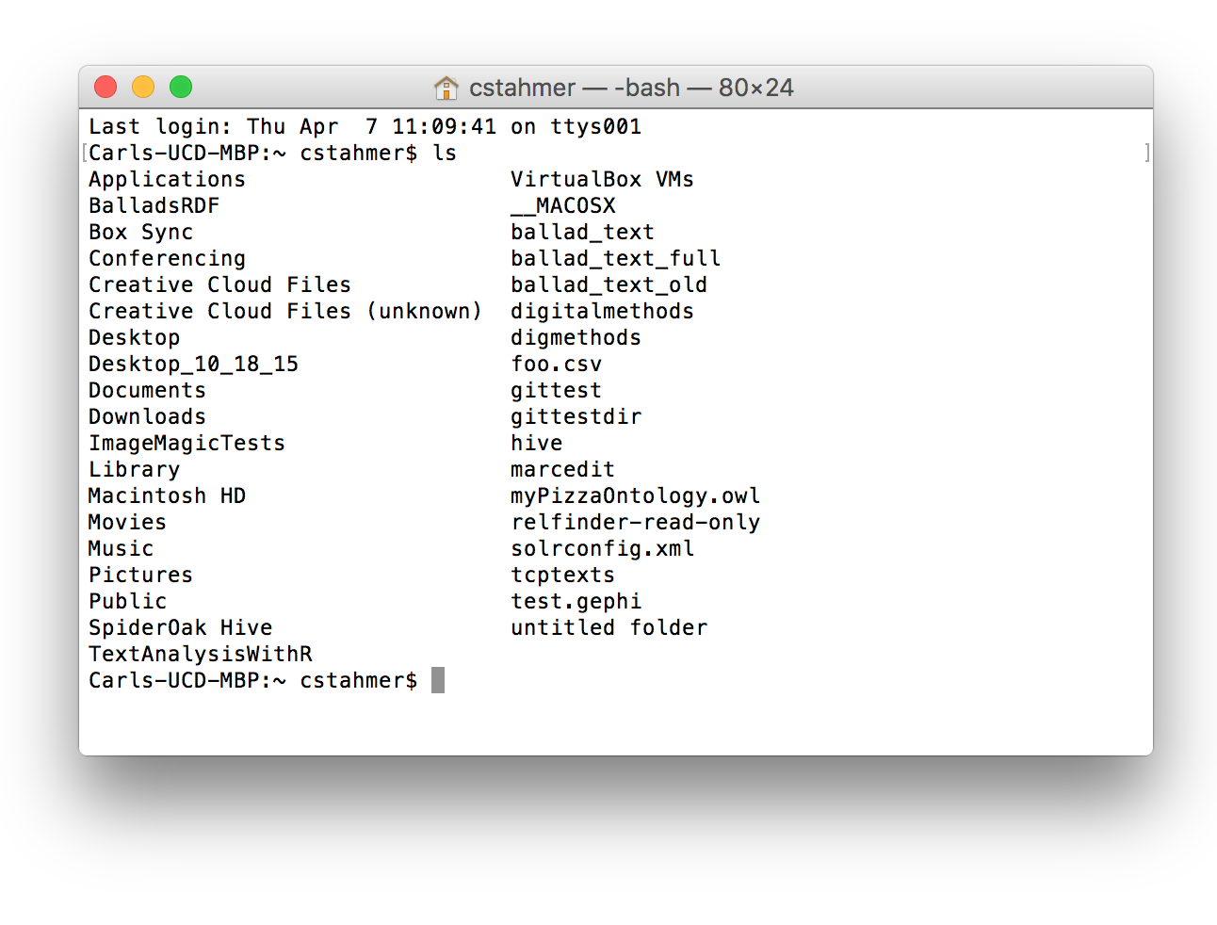
The Terminal Widow
Goto Terminal

Slide 10
Command | Example | Description
ls | ls La –a | List files in a directory
cd | cd /root/dir cd ../ | Change directory
cp | cp file1 file2 | Copy file1 as file2
mv | mv file1 /file2 | Move file one to root and name file2
rm | rm file1 | Delete file1
mkdir | mdkir photos | Made a new directory named photos
rmdir | rmdir photos | Remove photos directory
more | more file1 | Read file1
man | man ls | Show manual for ls
Essential Unix Commands
@cstahmer

Slide 11
Command | Example | Description
grep | grep ”string” file | Search files
chmod | chmod 777 file1 | Change permissions
kill | Kill -9 192312 | Kill process ID
pushd | pushd ./photos | Move into photos directory
popd | popd | Pop back up from pushd
diff | diff file1 file2 | Compare two files
pwd | pwd | Show current directory
history | history | Prints your terminal history
Useful Unix Commands
@cstahmer

Slide 12
Command | Example | Description
who | who | Tell you who you are
finger | finger | Tells you who’s on network
<up arrow> | <up arrow> | Traverse back through previous command stack
<down arrow> | <down arrow> | Traverse back down through command stack
date | date | Show date
fortune | fortune | Random humorous message
rev | rev | Reverses any string
<control>Z | <control>Z | Stops a process
Fun Unix Commands
@cstahmer

Slide 13
The Terminal Widow
Goto Terminal

Slide 14

@cstahmer
Open Source Distributed Version Control

Slide 15
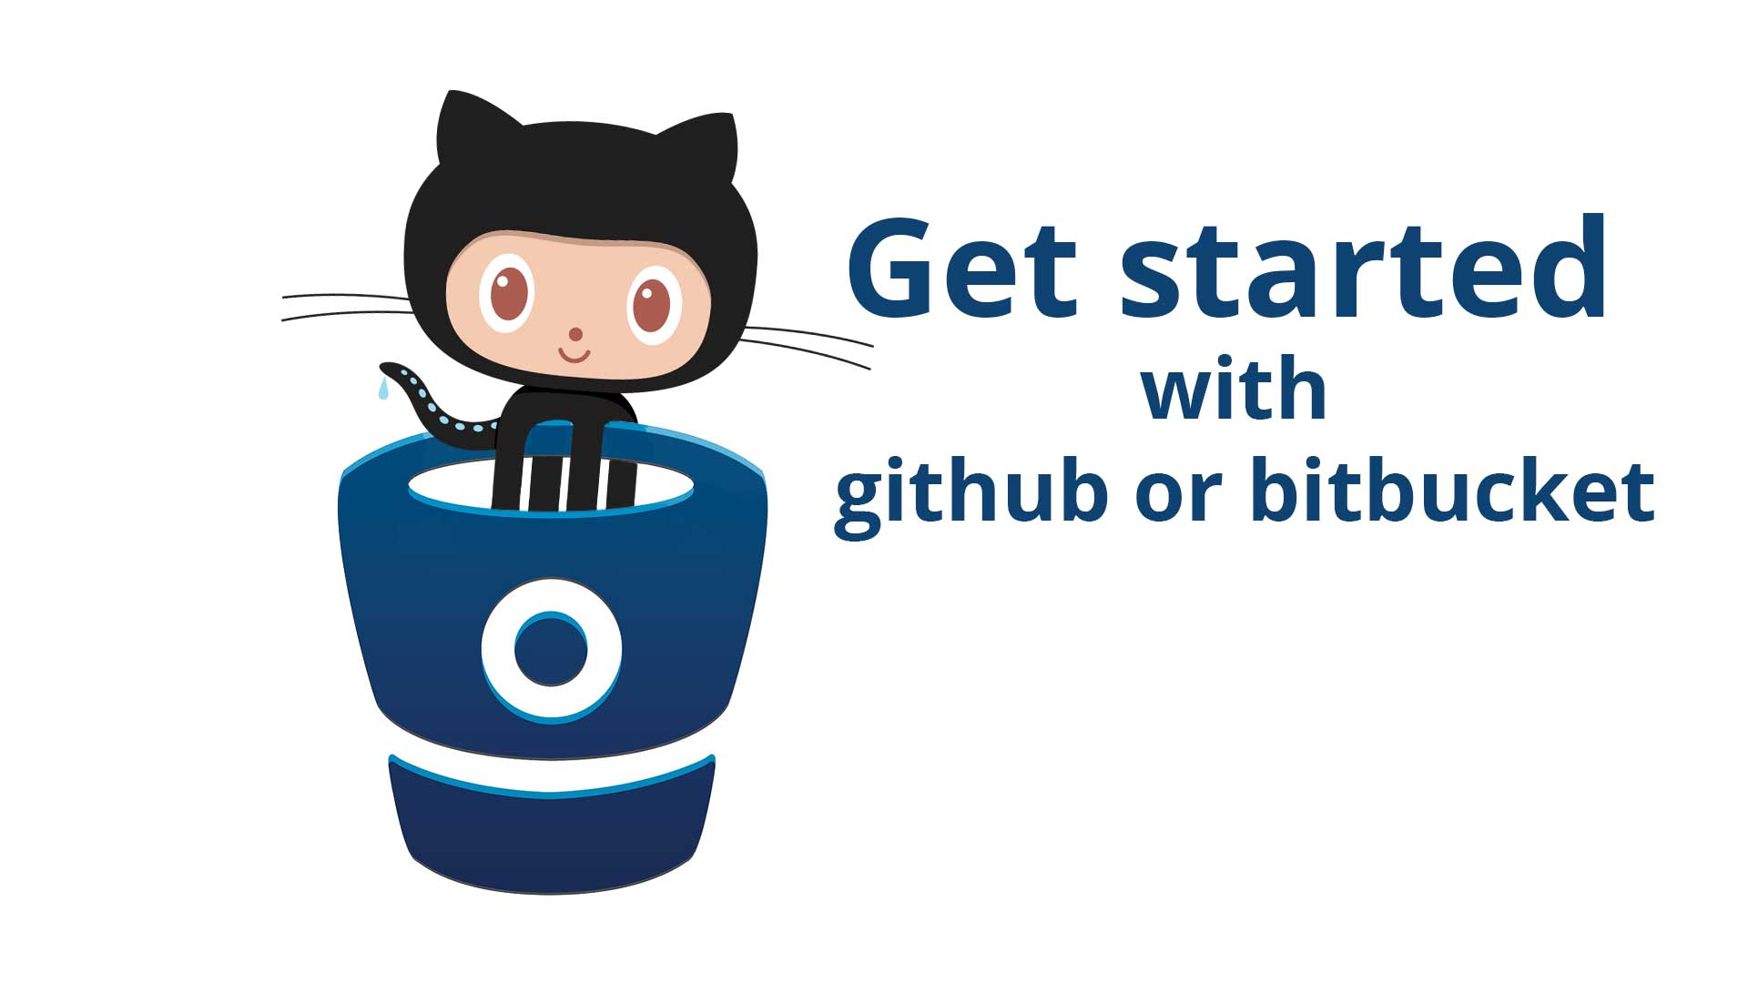

@cstahmer
Multiple Git Repositories

Slide 16
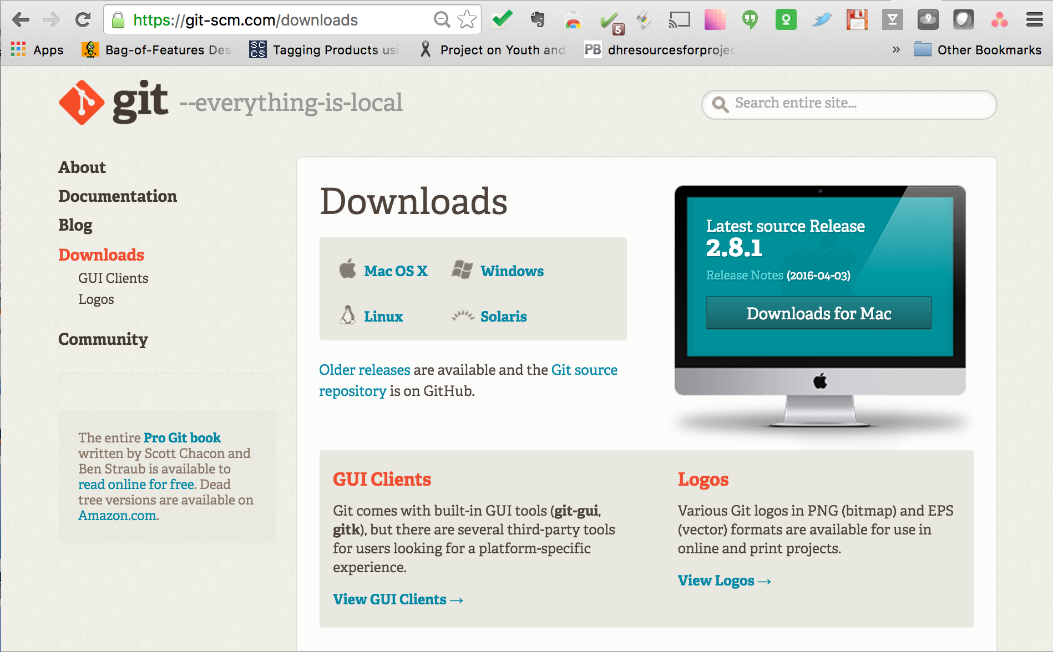
https://git-scm.com/downloads

Slide 17
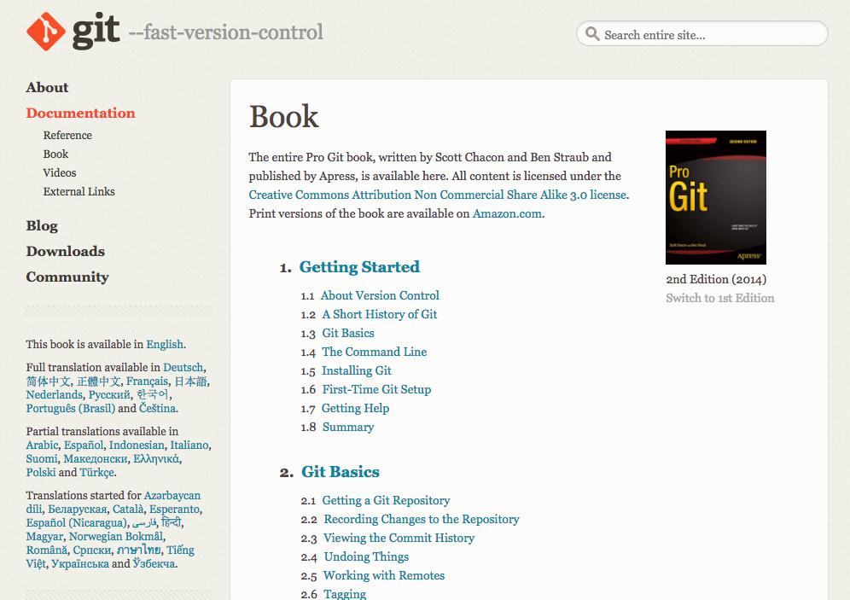
https://git-scm.com/book/en/v2

Slide 18
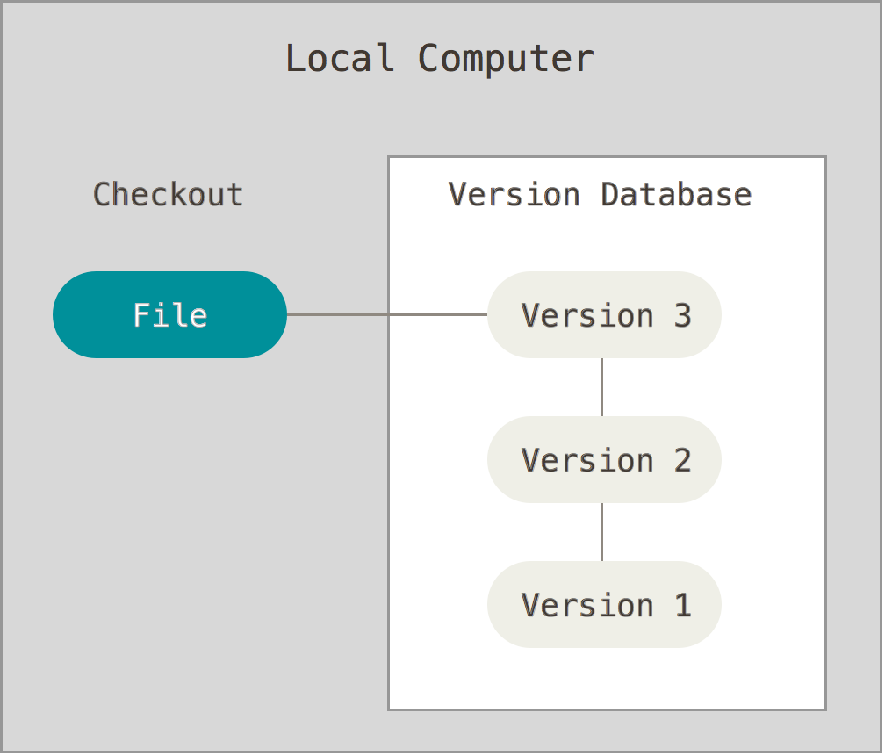
What is Open Source Version Control?

Slide 19
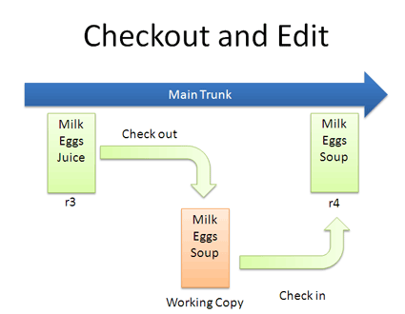
What is Open Source Version Control?

Slide 20
What is Open Source Distributed Version Control?
Push
Central
Repository
Pull
User 1
User 2
User 3

Slide 21
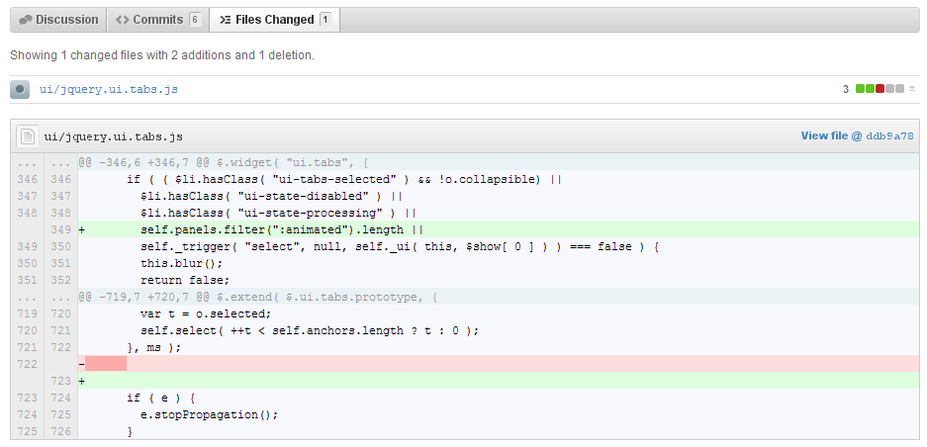
Change History

Slide 22
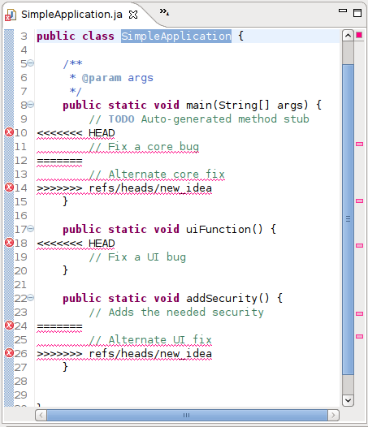
Conflict
Resolution
@cstahmer

Slide 23
Most Important: Revert
Version 1
Version 2
Version 3
Version 2
X

Slide 24
Command | Example | Description
git init | cd /directory/to/control git init | Puts the working directory under Git control
git status | git status | Returns status information about the repository
git branch | git branch | Tell you on which branch you are currently working
git add | git add filename | Adds the specified file to the staging area
git commit –m | git commit –m | Commits the staged files
Beginning to Git

Slide 25
Command | Example | Description
git checkout -b | git checkout –b newbranch | Creates a new branch and checks it out
git checkout | git checkout master | Checks out the named branch
git add | git add filename | Adds a file to the Staging Area
git commit –m | git commit –m | Commits staged files with entered comments
git commit | git commit | Commits the staged files and prompts for comments
Branching and Merging

Slide 26
Creating a Local Repository
Step 1: Create directory for new repository
Step 2: CD into new directory
Step 3: Check repository status
Step 4: Add some files to the directory

Slide 27
Committing Changes to Repository
Step 1: Check status to see what’s changed
Step 2: Add changed files to Staging Area
Step 3: Check status to see changes
Step 4: Commit changes
Step 5: View Log

Slide 28

Branching
Step 1: See branches
Step 2: Create new branch
Step 3: See new branch
Step 4: Switch between branches

Slide 29
Merging
Step 1: Commit changes to working branch
Step 2: Checkout branch you want to merge into
Step 3: Merge branch

Slide 30
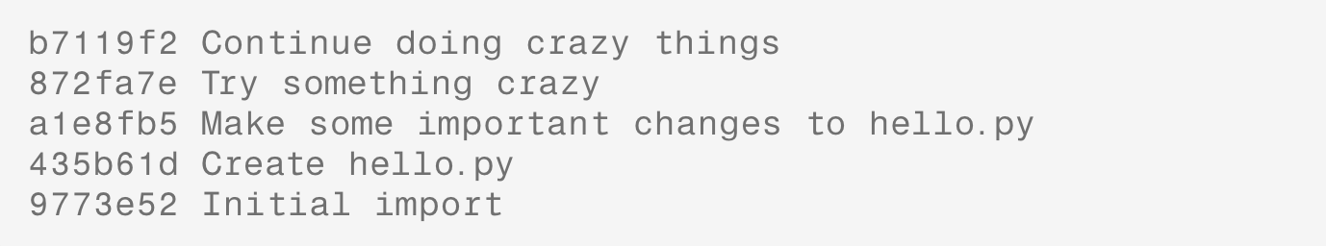
Reverting
Version 1
Version 2
Version 3
Version 2
X
Step 1:
Identify Version

Slide 31
Reverting
Version 1
Version 2
Version 3
Version 2
X
Step 2: View files from a commit to verify version
Step 3: Get back current commit
Step 4: Reset staging and history

Slide 32
Reverting
Version 1
Version 2
Version 3
Version 2
X
Step 4: Checkout the file version you want
Step 5: Add the file to the Staging Area
Step 6: Commit

Slide 33
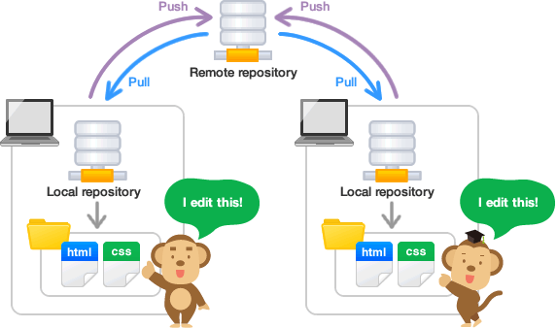
Working with Remote Repositories

Slide 34
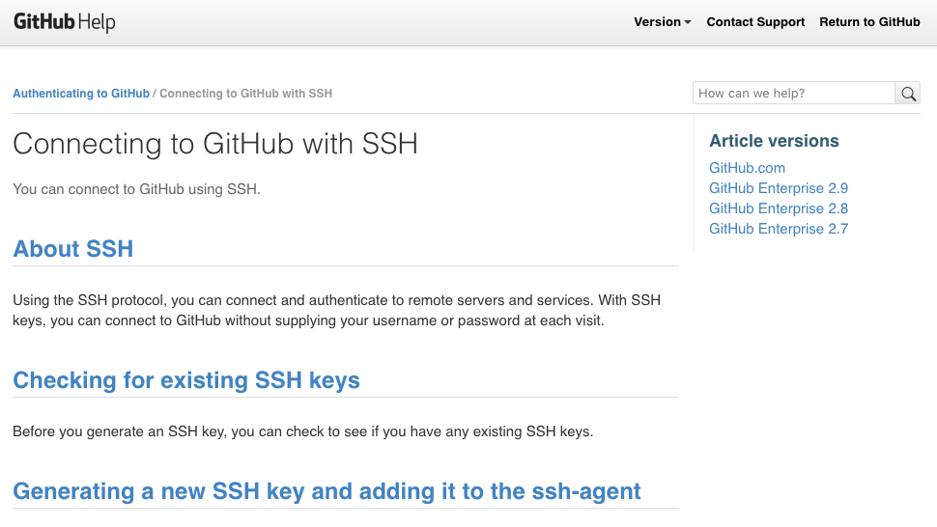
https://help.github.com/articles/connecting-to-github-with-ssh/

Slide 35
Command | Example | Description
git checkout -b | git checkout –b newbranch | Creates a new branch and checks it out
git checkout | git checkout master | Checks out the named branch
git add | git add filename | Adds a file to the Staging Area
git commit –m | git commit –m | Commits staged files with entered comments
git commit | git commit | Commits the staged files and prompts for comments
Working with Remotes

Slide 36
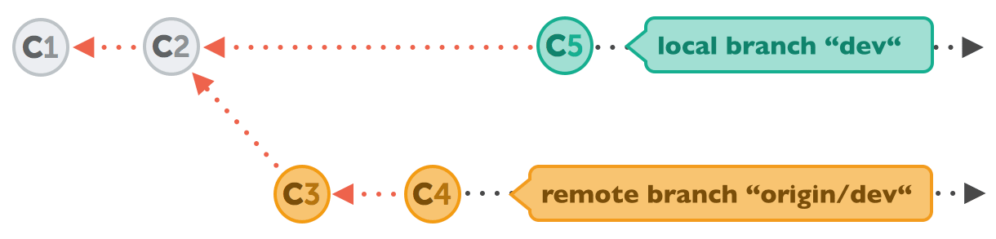
Fetch Remote
Step 1: Create directory for new repository
Step 2: CD into new directory
Step 3: Add origin repository
Step 4: Fetch remote repository metadata
Step 4: Fetch remote repository metadata

Slide 37
Fetch Remote Simple
Step 1: Clone remote repository

Slide 38
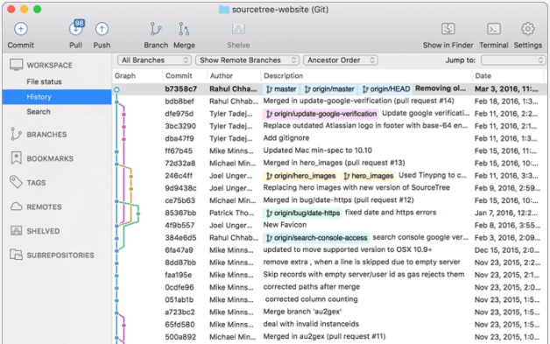
Git GUI
https://git-scm.com/downloads/guis

Slide 39
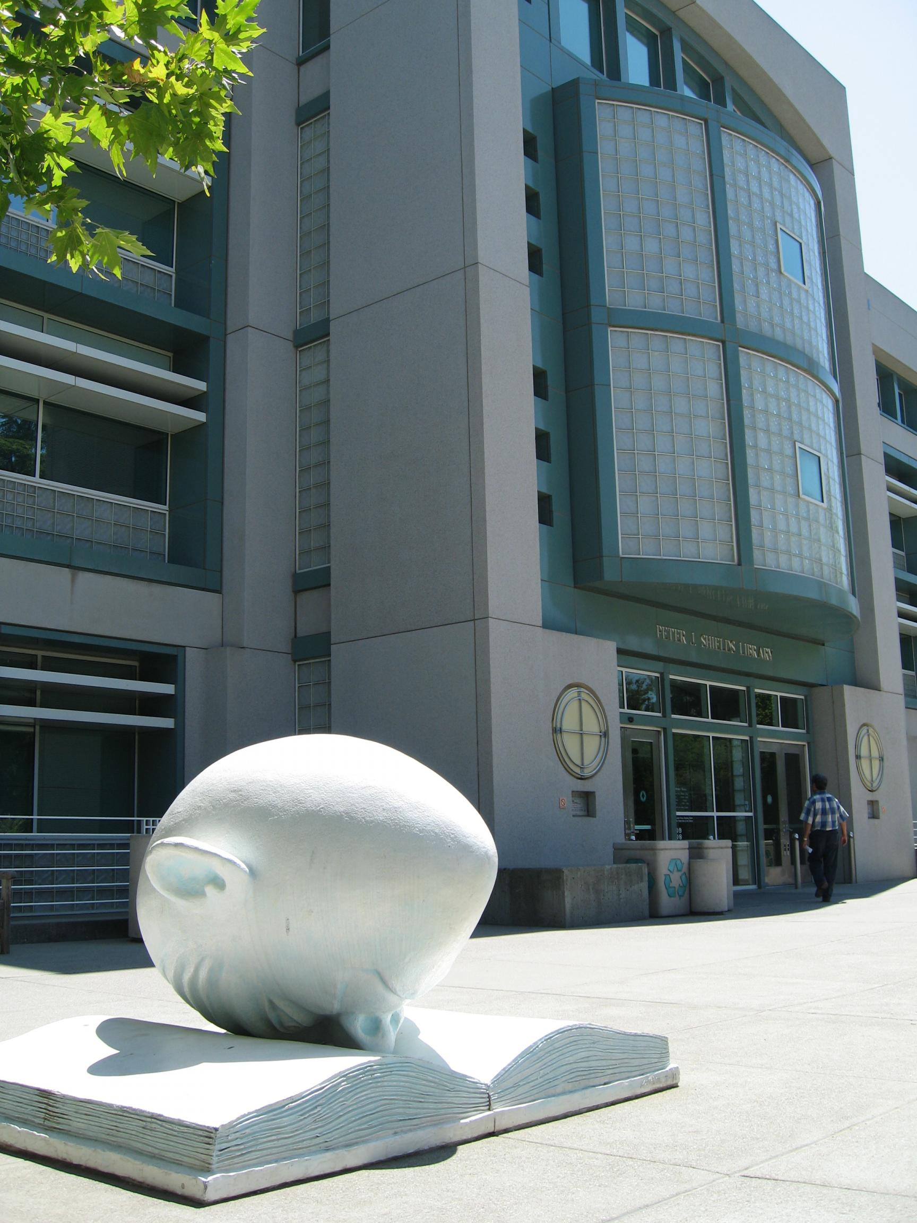

Thank You
Carl G. Stahmer
Director of Digital Scholarship
Associate Director for Humanities
UC Davis Data Science Initiative
www.carlstahmer.com
www.digitalscholarslab.org
@ cstahmer
Ultra Basic Guide to the
Command Line and Git
Rare Book School
July, 2017

